Slide 1
History Heroes Term 1, Week 1
https://www.youtube.com/watch?v=lXgkuM2NhYI 0.50-1.00

Slide 2
Question 1
What is the period of study (years) we are looking at for unit 1?

Slide 3
Question 2
What are the four types of assessment in modern history?

Slide 4
Question 3
What economic system do we look at when studying American history?

Slide 5
Question 4
What years did the American civil war begin and end?

Slide 6
Question 5
The years between 1870-1890 are known as the _________ Age in American history.

Slide 7
ANSWERS

Slide 8
Question 1
What is the period of study (years) we are looking at for unit 1?
1907–1941

Slide 9
Question 2
What are the four types of assessment in modern history?
Historical inquiry, explanation (essay), source analysis, examination

Slide 10
Question 3
What economic system do we look at when studying American history?
Capitalism

Slide 11
Question 4
What years did the American civil war begin and end?
1861 – 1865

Slide 12
Question 5
The years between 1870-1890 are known as the _________ Age in American history.
The Gilded Age

Slide 13


Source
of
the
week!

Slide 14
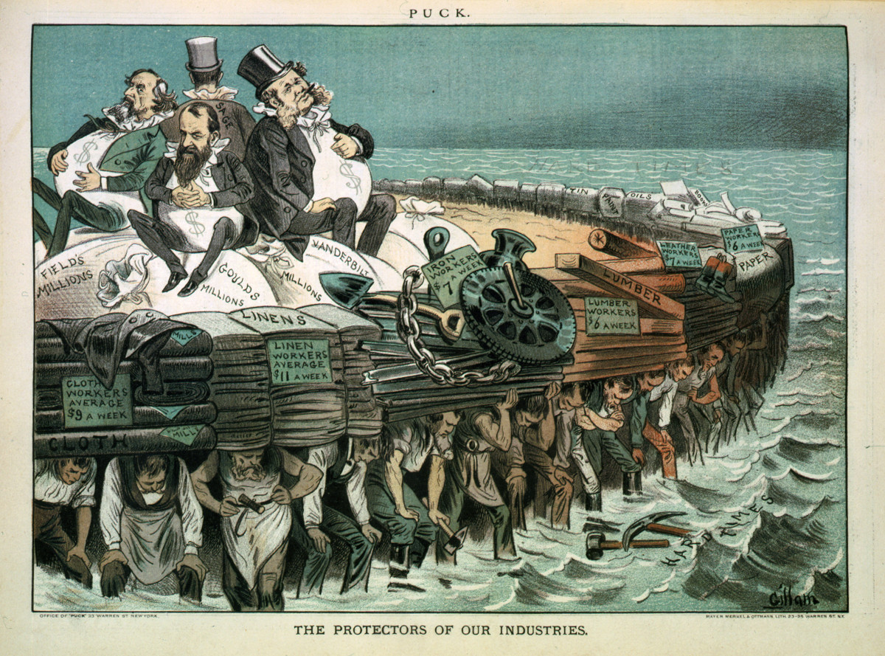
Title: The protectors of our industries
Creator(s): Gillam, Bernhard, 1856-1896
Date Created/Published: N.Y. : Published by Keppler & Schwarzmann, 1883 February 7.
Summary: Cartoon showing Cyrus Field, Jay Gould, Cornelius Vanderbilt, and Russell Sage, seated on bags of "millions", on large raft, and being carried by workers of various professions.
https://www.loc.gov/pictures/item/94507245/

Slide 15
History Heroes Term 1, Week 2
https://www.youtube.com/watch?v=lXgkuM2NhYI 0.50-1.00

Slide 16
Question 1
What is the period of study (years) we are looking at for unit 1?

Slide 17
Question 2
The years between 1870-1890 are known as the _________ Age in American history.

Slide 18
Question 3
What are the acronyms we use to remember essay structure (and what do each of them stand for?)

Slide 19
Question 4
Capitalism is define as…

Slide 20
Question 5
What is Andrew Carnegie known for?

Slide 21
Question 6
From the 1890s onwards, most migrants to the United States came from…

Slide 22
Question 7
The Progressive Era is a term used to describe the USA between the dates….(years)?

Slide 23
Question 8
What year marked the beginning of WW1?

Slide 24
ANSWERS

Slide 25
Question 1
What is the period of study (years) we are looking at for unit 1?
1907-1941

Slide 26
Question 2
The years between 1870-1890 are known as the _________ Age in American history.
Gilded

Slide 27
Question 3
L – lead in idea
A – Answer the question
M – Menu
T – Topic sentence
E – Explanation
(e)X – Example
R – Round off
A – answer the question
M – Menu
L – Lead out

Slide 28
Question 4
Capitalism is define as…
An economic and political system in which a country’s trade and industry are controlled and owned by private individuals.

Slide 29
Question 5
What is Andrew Carnegie known for?
Wealthy businessman in the steel and iron industries.

Slide 30
Question 6
From the 1890s onwards, most migrants to the United States came from…
Italy, Russia, and the Austro-Hungarian Empire

Slide 31
Question 7
The Progressive Era is a term used to describe the USA between the dates….(years)?
1900-1916

Slide 32
Question 8
What year marked the beginning of WW1?
1914

Slide 33
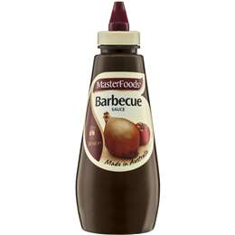
Source
of
the
week!

Slide 34
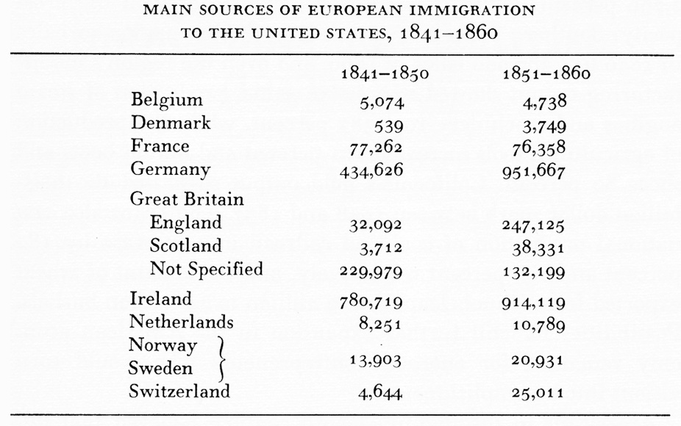
http://www.latinamericanstudies.org/immigration-statistics.htm

